Slide 1

Team 1 - Sprint 6
SLW Home Improvements
Members
Carson Hatem – Systems Analyst
Austin Bing-Zaremba – Business Analyst
Christian Lancaster – Co-Product Owner
Jackson Ingalls – Database/Programming Coordinator

Slide 2
Introduction
SLW Home Improvements is a fabrication-focused company based in Greenville, North Carolina
As the company grew, it became clear that their existing methods were no longer sufficient
Our MIS 4173 project team partnered with SLW Home Improvements to design and implement a custom digital solution
The goal was to develop a website integrated with a secure database to streamline operations
This system enables customers to request quotes, view services, and contact the company online, while also giving administrators tools to manage quotes, update services, and maintain customer records with ease

Slide 3
Problem Analysis
Key problems identified include:
Inefficient Data Management: Customer records and pricing information were scattered across documents, increasing the likelihood of data entry errors, duplication, and lost information.
No Online Presence: Without a website, SLW lacked visibility in the digital marketplace, limiting customer outreach and missing opportunities to generate new business.
Limited Customer Interaction Tools: Customers had no self-service options for requesting quotes, viewing services, or contacting the company, which slowed down communication and delayed service delivery.
Manual Workflows: Employee productivity was affected by the time-consuming nature of managing service requests and follow-ups without automation or centralized data access.

Slide 4
Problem Analysis
To solve these challenges, we analyzed the company’s needs using three approaches:
BPA (Business Process Automation): Automating data entry and retrieval to save time and reduce errors.
BPI (Business Process Improvement): Creating a central database to make it easier to access and update customer records and pricing.
BPR (Business Process Reengineering): Designing a website where customers can communicate with the company and request services online.

Slide 5
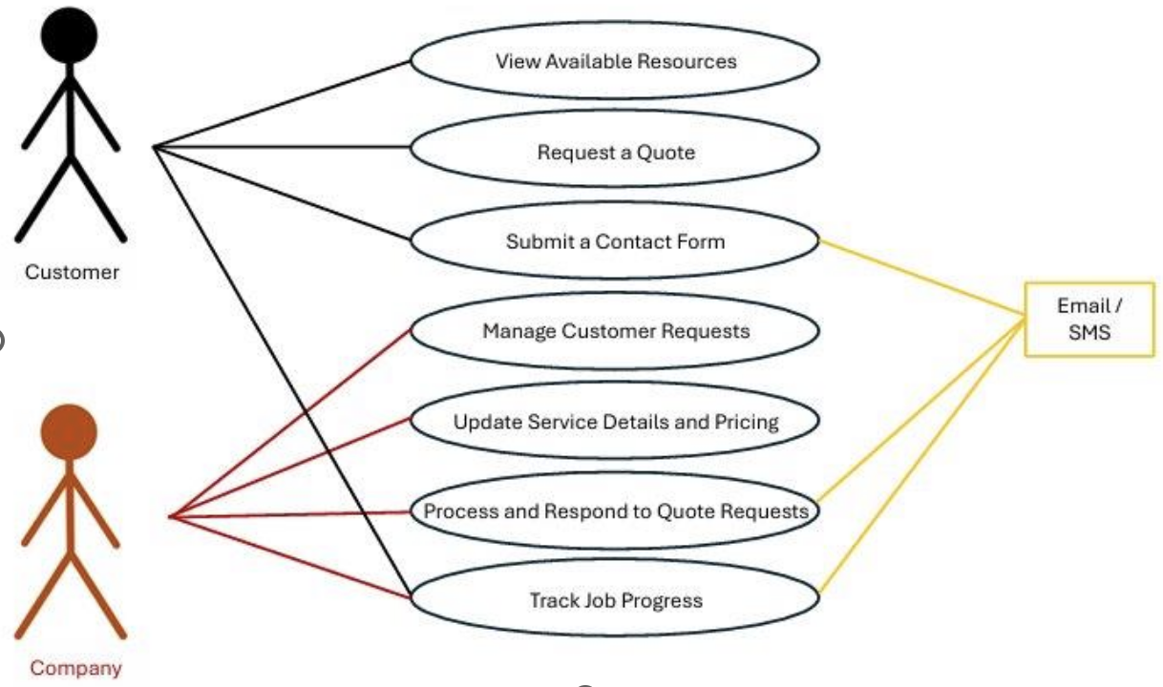
Use Case Diagram

Slide 6
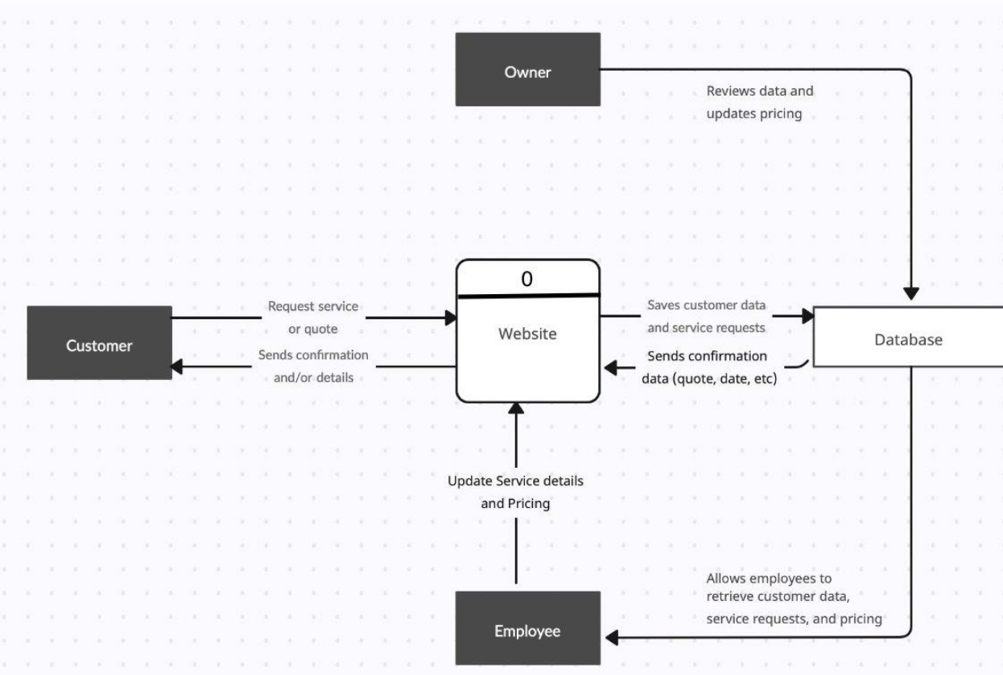
DFD L0

Slide 7
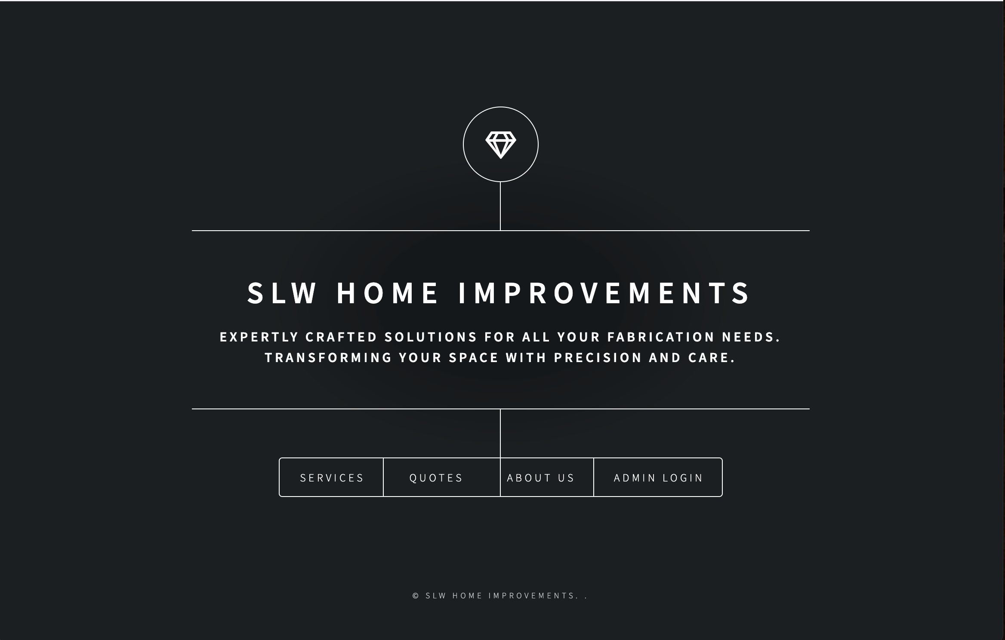
Finished System Demo

Slide 8
Lessons Learned
Importance of gathering clear, detailed requirements early on
Agile sprints helped us adapt quickly to feedback and changes
Prioritizing security early made integration smoother
Simple, user-friendly design is just as important as functionality
Thorough testing helped prevent deployment issues
Well-written documentation ensures long-term system usability

Slide 9
Challenges
No existing digital system — operations were pen-and-paper based
Required complete system build, website, database, and admin tools
Limited technical experience among end-users
Balancing ease of use with functional requirements

Slide 10
Problems
Difficulty gathering requirements without prior systems to reference
Inconsistent or incomplete data in manual records
Risk of overwhelming users with complex features
Limited timeline to develop, test, and deploy a full solution

Slide 11
Discoveries
Simpler interfaces are more effective for non-technical users
Frequent demos and feedback loops improved design decisions
Starting from scratch allowed full customization without legacy constraints
Thorough user training and documentation is key for adoption

Slide 12
Questions?

